Slide 1


OPERATIONS DASHBOARD
2022
E-470 PUBLIC HIGHWAY AUTHORITY
Quarterly Operations Dashboard Report
Third Quarter

Slide 2


TABLE OF CONTENTS
  Contact Center
  Advanced Account Advisors
  Image Processing
  DMV Lookups
  Printed Mailings
    Print and Postage Cost
  Media Relations
  Marketing and Communications
    Email Campaign Results
    Social media stats

Slide 3
EXPRESSTOLL ACCOUNTS OPENED
2021 |  | 2022
Q1 Retail | 600 | Q1 Retail | 663
Q2 Retail | 670 | Q2 Retail | 588
Q3 Retail | 873 | Q3 Retail | 661
Total | 2,143 |  | 1,912
Q1 CSR | 7,916 | Q1 CSR | 10,479
Q2 CSR | 8,313 | Q2 CSR | 11,349
Q3 CSR | 12,349 | Q3 CSR | 12,827
Total | 28,578 |  | 34,655
Q1 Web | 13,521 | Q1 Web | 23,433
Q2 Web | 18,561 | Q2 Web | 22,809
Q3 Web | 26,931 | Q3 Web | 23,860
Total | 59,013 |  | 74,102
2021 Total | 89,734 | 2022 Total | 110,669
Total Retail | 1,912 | Decrease of 10.78% from 2021
Total CSR | 34,655 | Increase of 21.26% from 2021
Total Web | 74,102 | Increase of 25.57% from 2021
Total new accounts increased by 23% from 2021!

Slide 4
CONTACT CENTER - VOLUME
CSAT remains consistent at 98.9%
NPS up at 80.69%

Slide 5
CALL CENTER - EMAILS
Total Q3 2021: 24,211
Total Q3 2022: 22,433
Decrease from 2021: 7.34%
2020
2021
2022
Q2 Emails: 20,550
Q3 Emails : 21,367
Q2 Emails: 21,111
Q3 Emails : 24,211
Q2 Emails: 23,172
Q3 Emails: 22,433

Slide 6
CALL CENTER – CALL DRIVERS
Account Updates, Misread Plate, and Registration Hold have decreased from Q2
Transfer to Secure IVR, Payment, and Online Portal have increased from Q2
Billing Questions/Dispute Dispositions have remained the same as Q2

Slide 7
ADVANCED ACCOUNT ADVISORS
Total Q3 2021: 17,665
Total Q3 2022: 21,506
Increase from 2021: 21.74%
2021
20,798 calls in Q2
17,665 calls in Q3
2022
19,235 calls in Q2
21,506 calls in Q3
2021 vs 2022
59,526 calls in 2021 YTD
61,090 calls in 2022 YTD

Slide 8
ADVANCED ACCOUNT ADVISORS
Total Q3 2021: 150,340
Total Q3 2022: 151,406
Increase from 2021: 0.71%
2021 Transponders Filled
Q2: 123,891
Q3: 150,340
2022 Transponders Filled
Q2: 137,392
Q3: 151,406
2022 Walk-Ups
1,335 walk-up customers in Q2
1,499 walk-up customers in Q3

Slide 9
IMAGE PROCESSING
Total Q3 2021: 17,486,597
Total Q3 2022: 19,483,717
Increase from 2021: 11.42%

Slide 10
DMV LOOKUPS
*Represents paid lookups from Penn Credit, LES/Duncan Solutions, Nebraska and Wyoming

Slide 11
PRINTED MAILINGS

Slide 12
PRINT & POSTAGE COST

Slide 13
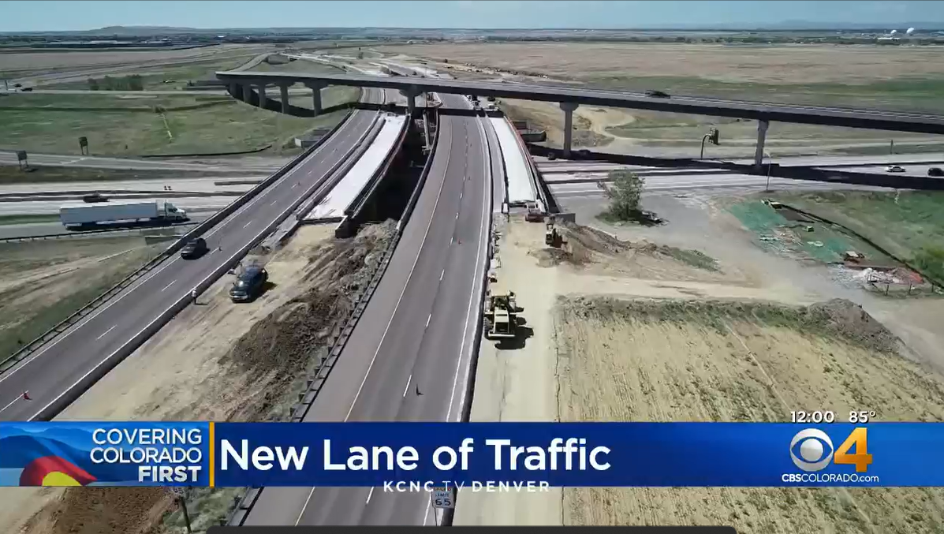
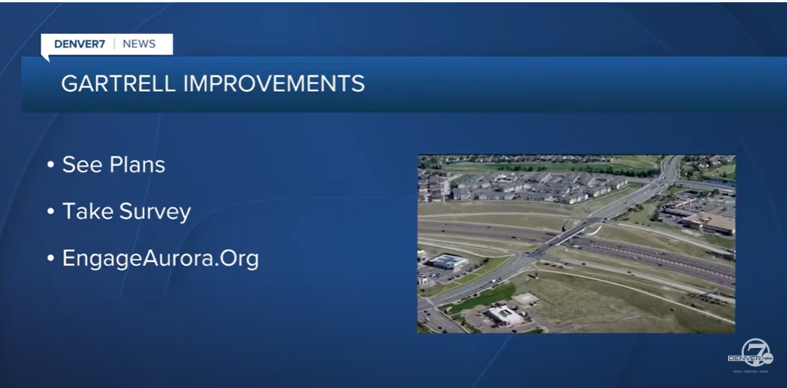
MEDIA RELATIONS
Proactive Media
Gartrell Interchange Improvements Survey
  Joint press release with City of Aurora
  Covered by Denver 7: 5,741 viewers
Construction Begins on E-470 Road Widening & Trail Expansion
  Covered by Denver Post, CBS4, Denver 7, 9News, KOA, 95.7, and Reason.org
  Total viewers: 354,549
IBTTA 2022 Toll Excellence Award Winners
  IBTTA issued press release
Reactive Media (not all resulted in a news story)
Denver 7 (two inquiries)
CBS4 (two inquires)
Denver Post
Westword
9News

Slide 14
MARKETING & COMMUNICATIONS
YTD Marketing and Communications Analytics – through September 2022 | YTD Budget | YTD Revenue | Promo Accounts
 | $2321683.09 | $1,014,030.22 | 11,573
 | Mktg. Spend/New Promo Account | Revenue / New Account | Net Income / New Account | Net Income | ROI
 | $20.11 | $87.62 | $67.51 | $781,347.13 | 336%
Marketing Spend / New Promo Account = YTD Budget / Promo Accounts
Revenue / New Account = YTD Revenue / Promo Accounts
Net Income / New Account = (Revenue / New Account) – (Mktg. Spend / New Promo Account)
Net Income = YTD Revenue – YTD Budget
ROI = Net Income / YTD Budget

Slide 15
MARKETING & COMMUNICATIONS

Slide 16
MARKETING & COMMUNICATIONS
CSR Promo: A promo code used by Customer Service Representatives to open accounts while helping customers.
LPT Inserts: An ExpressToll advertisement included in statements sent to License Plate Toll customers.
Paid Advertising: Accounts opened via paid efforts planned by our advertising agency, CIG.

Slide 17

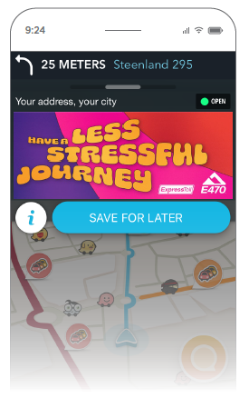
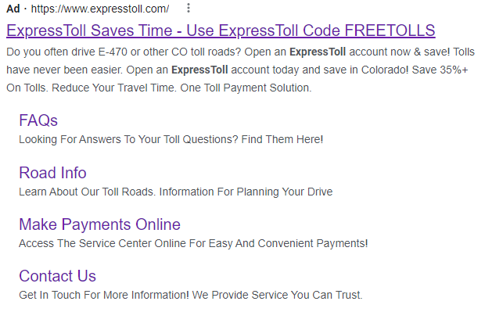
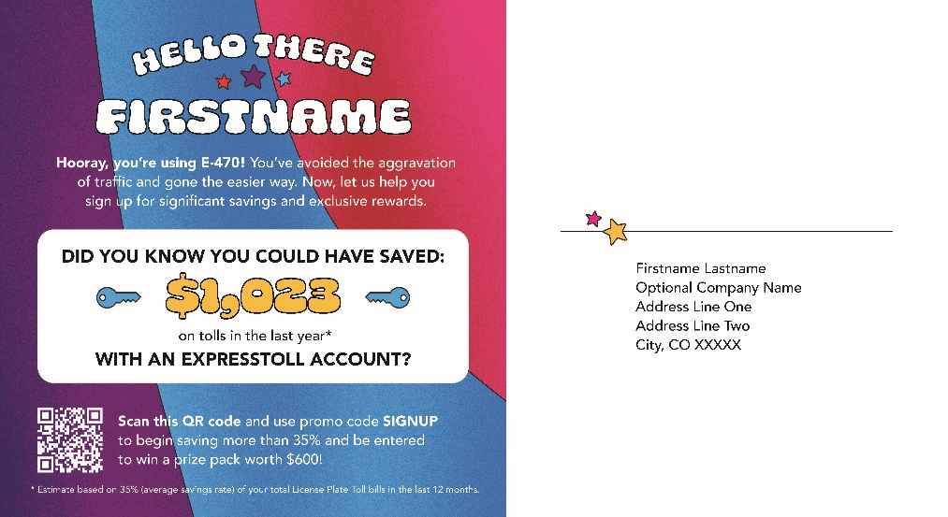
MARKETING & COMMUNICATIONS
Q3 Advertising Outlets:
  Website display
  Google Ad Words
  Waze
  Pre-roll online video
  Streaming audio
  Direct Mailer

Slide 18
EMAIL MARKETING - OVERVIEW
Action Rate: Percentage of customers in the category who corrected their account.

Slide 19
EMAIL MARKETING - OVERVIEW

Slide 20
EMAIL MARKETING – NEGATIVE BALANCE

Slide 21
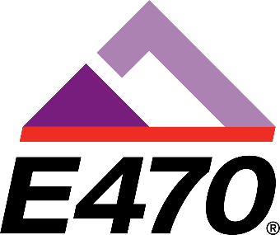

SOCIAL MEDIA
Q3 Social Media Snapshot
Platform | Facebook | Twitter | Instagram | LinkedIn | Road Updates | Total/Average
Followers | 20,141 | 3,151 | 871 | 1,370 | 1,541 | 27,074
Engagements | 1,236 | 354 | 220 | 2,329 | 75 | 4,214
Engagement Rate | 2.05% | 3.75% | 8.51% | 57.79% | 1.63% | 14.75%
Reach | 66,246 | 19,946 | 4,825 | 12,923 | 10,306 | 114,246
Platform | Facebook | Twitter | Total/Average
Followers | 4,497 | 403 | 4,900
Engagements | 13 | 20 | 33
Engagement Rate | 0.1% | 1.67% | 0.89%
Reach | 2,366 | 1,420 | 3,786

Slide 22
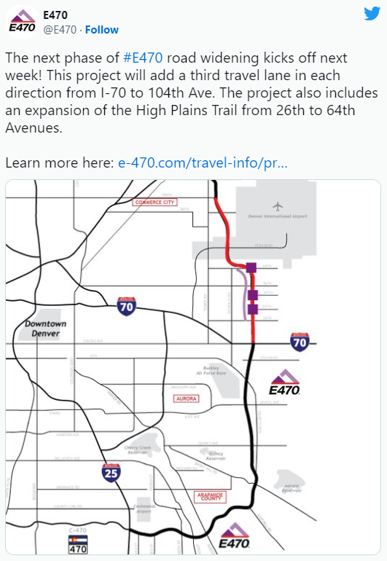
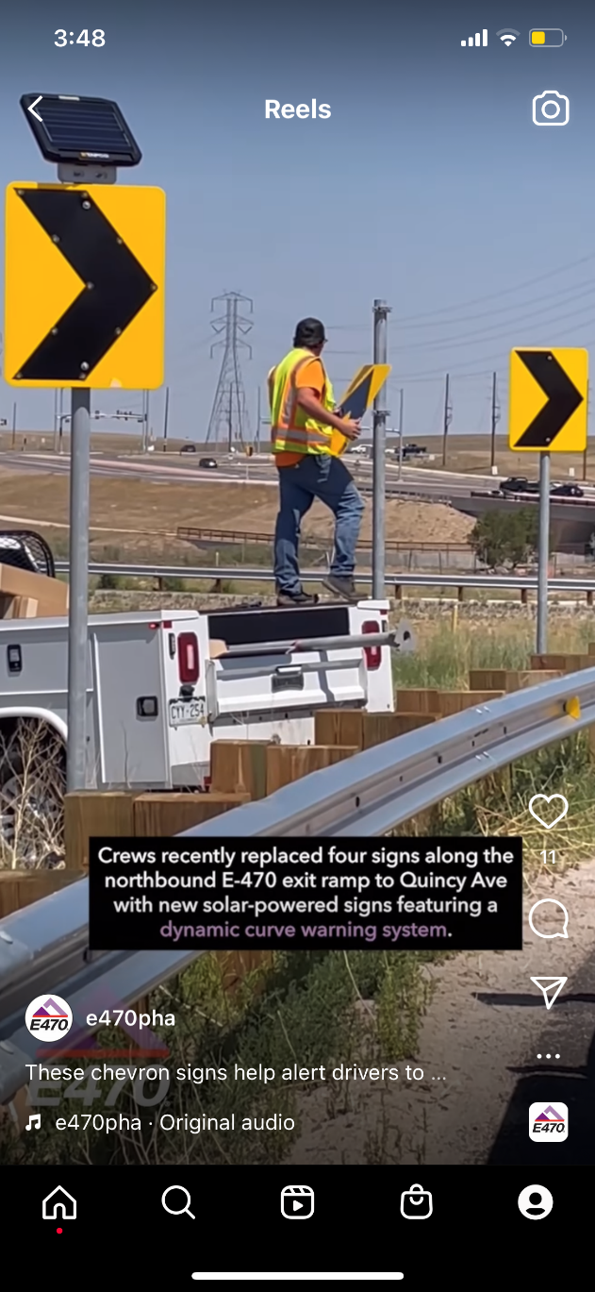

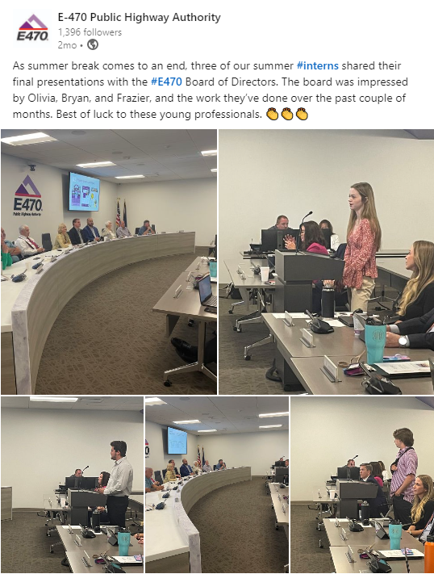


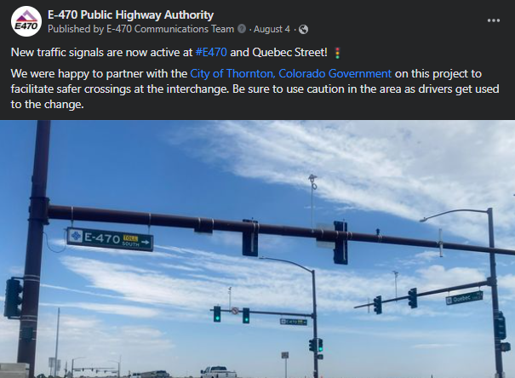

SOCIAL MEDIA
Q3 Top Social Media Posts

Slide 23


CONTACT INFORMATION
Jessica Carson | E-470 Operations Director
  303-877-7334
  jcarson@e-470.com
Tricia Morales | E-470 Customer Service Manager
  303-242-1717
  tmorale@e-470.com
Beau Memory | E-470 Executive Director
  bmemory@e-470.com
  E-470.com | ExpressToll.com

